Slide 1

AI StudyBuddy
Your Personalized AI Mentor for Competitive Exams
Team BIT BUSTERS

Slide 2

The Challenge: Hurdles for Competitive Exam Aspirants
Overwhelming Syllabus
Vast and disorganized content creates significant stress.
Lack of Structured Roadmap
Students struggle to define clear, effective study paths.
Limited Personalized Guidance
Generic coaching often fails to address individual learning needs.
Expensive Coaching Dependency
High costs exclude many deserving students from quality preparation.
Bilingual (Hindi + English) Gap
A significant barrier for non-English speaking aspirants.

Slide 3

Our Inspiration: Democratizing Exam Preparation
"Every student deserves access to personalized, affordable, and high-quality exam preparation, regardless of their background or language."
This core belief fueled our motivation to build AI StudyBuddy — a smart, bilingual AI mentor accessible to all, breaking down barriers to educational success.

Slide 4
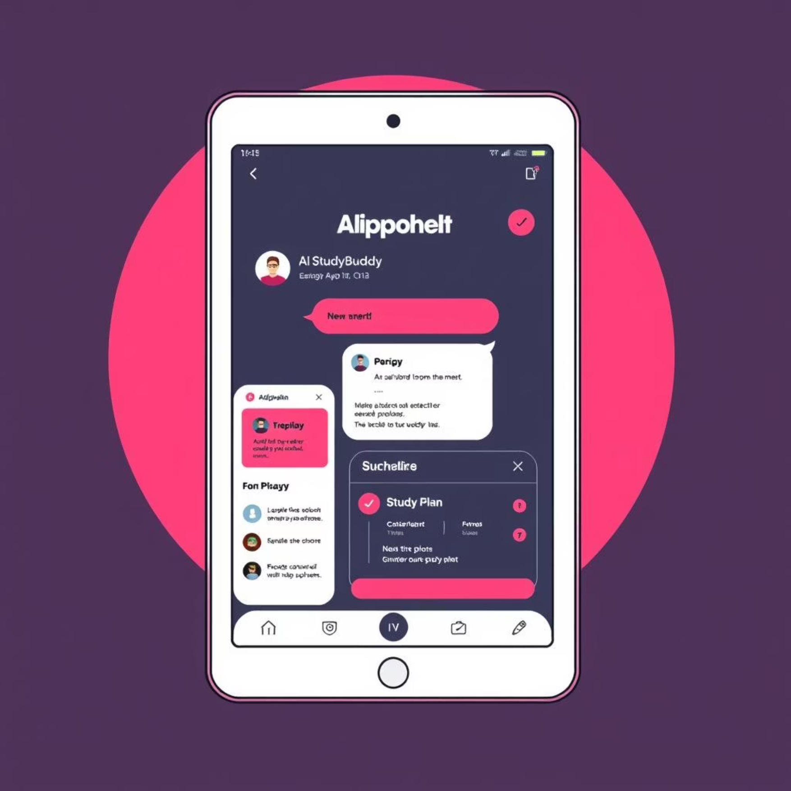




AI StudyBuddy: Your AI-Powered Solution
AI StudyBuddy is an intelligent, AI-powered platform designed to revolutionize competitive exam preparation for aspirants. We integrate cutting-edge technology to offer a truly personalized learning experience.
Instant Doubt Solving
Get step-by-step solutions for any query.
Personalized Study Roadmap
Dynamic planning and progress tracking tailored for you.
Bilingual Support
Seamless interaction in Hindi & English (text + voice).
Group Collaboration & Quizzes
Engage with peers and test knowledge together.

Slide 5





Our Approach: How AI StudyBuddy Works
Data Collection
AI Processing
Feature Integration
User Output
01
02
Data Ingestion & AI Modeling
Multimodal Input Integration
We collect comprehensive syllabus data and past year questions to train our AI models for advanced reasoning and bilingual response generation.
Users can provide input via text, audio, scanned PDFs, or images, making the platform highly versatile.
03
04
Personalized Roadmap Generation
Collaborative Learning Tools
AI creates dynamic study plans and tracks progress with real-time analytics.
Integrated features for group study, quizzes, and peer interaction to foster a supportive community.

Slide 6







Core Features: Empowering Every Aspirant
AI StudyBuddy offers a robust suite of features designed to cater to every aspect of competitive exam preparation. Each tool is crafted to provide maximum value and ease of use.
Doubt Solver
Q&A Recommendations
Personalized Roadmap
Instant, step-by-step solutions for complex problems.
Access similar questions and past year paper analysis.
Tailored study plans and adaptive learning paths.
Bilingual Support
Multimedia Input
Group Study Rooms
Seamless text and voice interaction in Hindi & English.
Scan handwritten notes or upload PDFs for analysis.
Collaborate, discuss, and learn with peers.
Real-time Progress
Track your performance and identify areas for improvement.

Slide 7
Under the Hood: Our Robust Tech Stack
AI StudyBuddy is built on a foundation of cutting-edge technologies, ensuring scalability, performance, and an intuitive user experience.
AI Models
Frontend
GPT-4o, Gemini, Hugging Face: For advanced reasoning and multilingual processing.
React + Tailwind CSS: For a responsive, modern, and intuitive user interface.
Speech
Backend
Whisper (voice input), TTS (voice output): Enabling seamless bilingual voice interaction.
FastAPI / Node.js: Powering fast and efficient data processing and API services.
Vision
Collaboration
OCR Technology: For accurate extraction of text from handwritten notes and PDFs.
Firebase / WebRTC: Facilitating real-time communication and group study features.

Slide 8
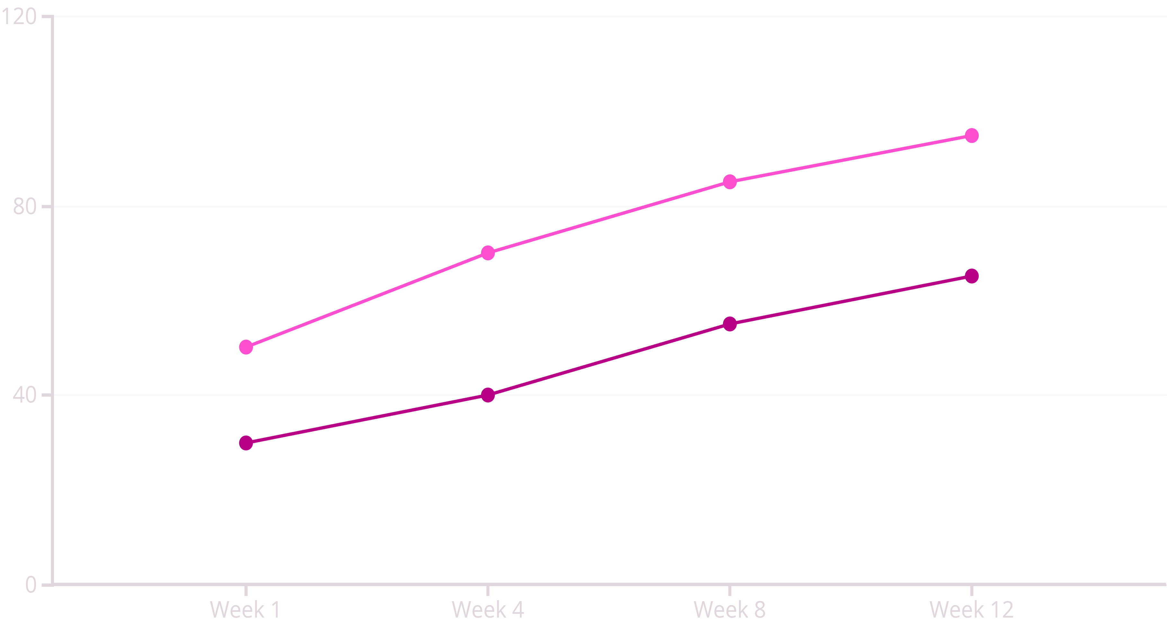





Expected Outcomes: Transforming Exam Prep
AI StudyBuddy is designed to deliver tangible benefits, creating a more equitable and effective learning ecosystem for competitive exam aspirants.
Student Confidence (without...
Student Confidence (with AI)
This illustrative chart shows the projected increase in student confidence and preparedness over time with the personalized guidance of AI StudyBuddy.
Affordable Prep
Inclusive Access
Enhanced Efficiency
Quality education made accessible to all.
Bridging the language gap with bilingual support.
Optimized learning paths and motivation.
Collaborative Learning
Democratizing Education
Fostering peer support and interactive study.
Empowering aspirations across all demographics.

Slide 9

Projected Impact: Reaching Millions
AI StudyBuddy is poised to make a significant difference in the lives of millions, fostering a more equitable and successful educational landscape.
Millions of Aspirants Supported
Scalable platform to reach a vast student base nationwide.
Rural + Urban Inclusivity
Breaking geographical barriers with accessible education.
Reduces Reliance on Costly Coaching
Providing a high-quality, affordable alternative.
Boosts Exam Success Rates
Personalized guidance leads to improved performance.

Slide 10
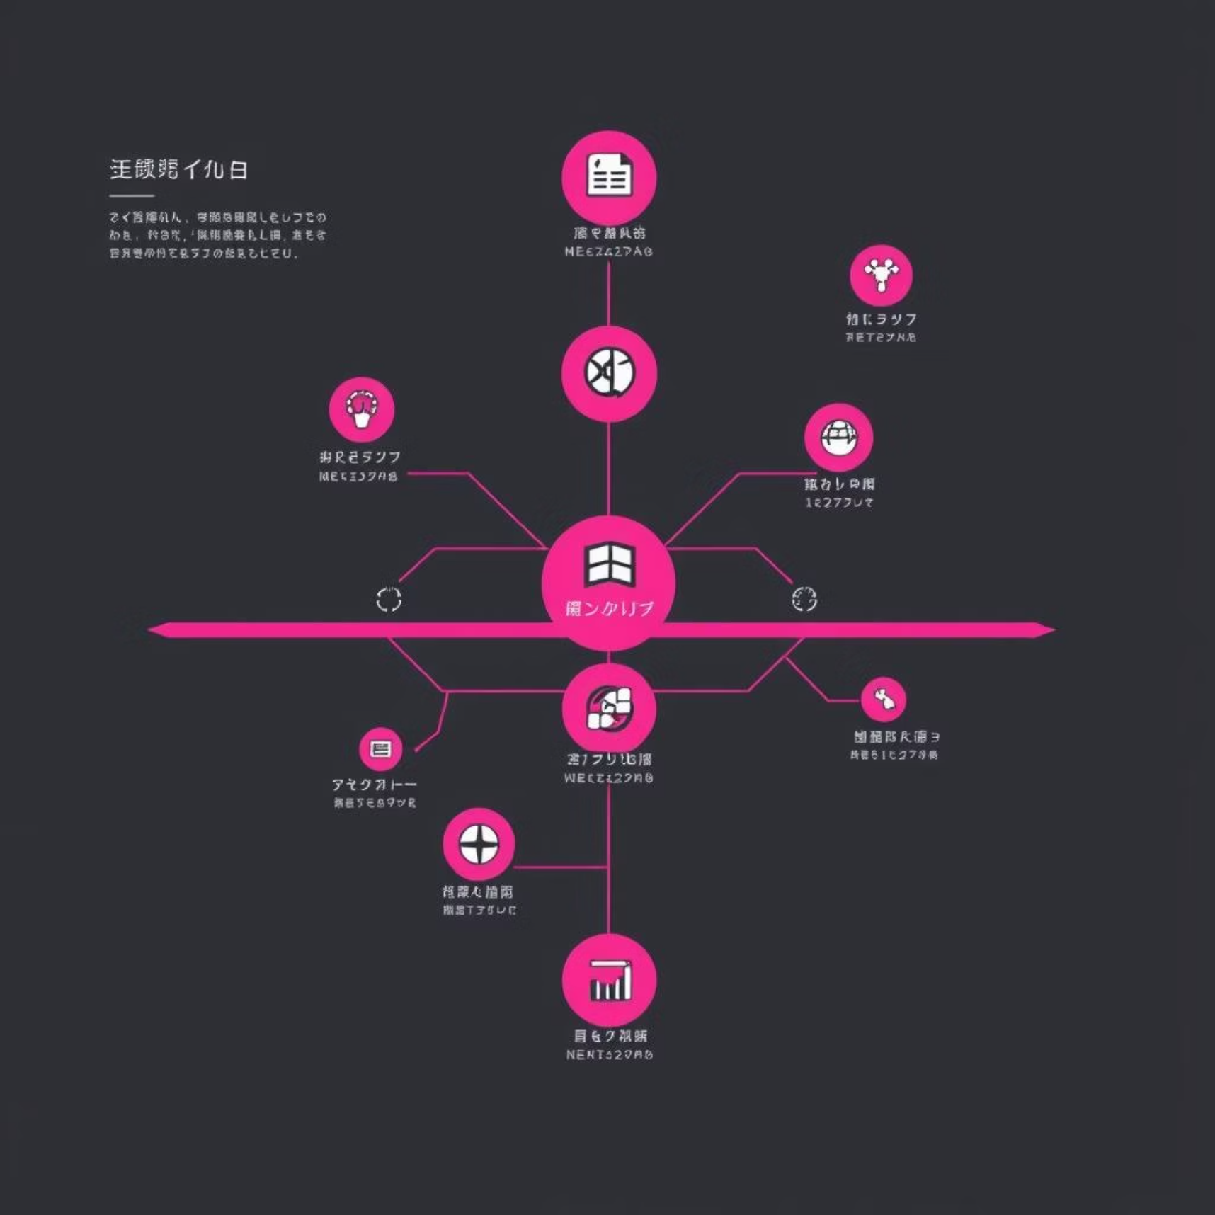

Future Scope: Expanding Horizons
Expand to More Exams
Covering a broader range of competitive exams across different fields.
AI-Based Mock Test Evaluation
Advanced analytics for comprehensive test performance review.
Gamification Features
Introducing leaderboards, streaks, and rewards to boost engagement.
Offline-First Access
Ensuring continuous learning for rural learners with limited internet connectivity.
AI StudyBuddy: Smarter Prep. Better Results. With AI.

Slide 11
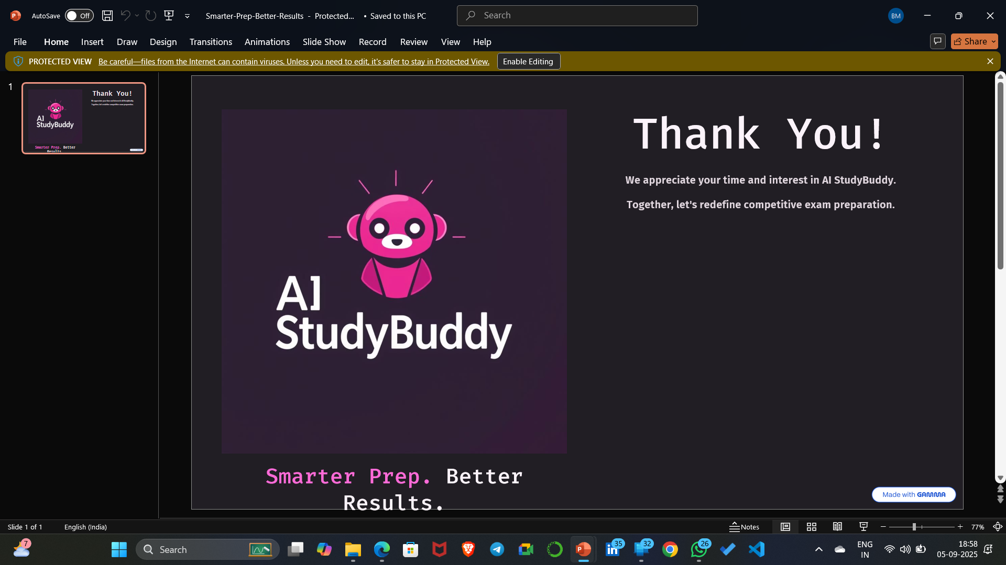
Smarter Prep. Better Results.
With AI.

